Slide 1
About Our Business

Slide 2
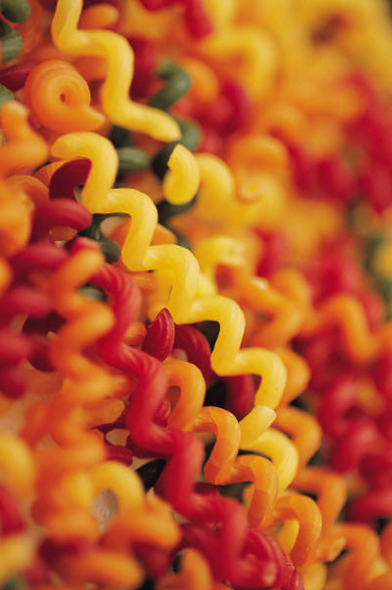
Our Mission
To create unique, high quality pastas, made by hand without additives or preservatives, for restaurants and individuals who choose to serve delicious, all-natural, one-of-a-kind pastas.

Slide 3
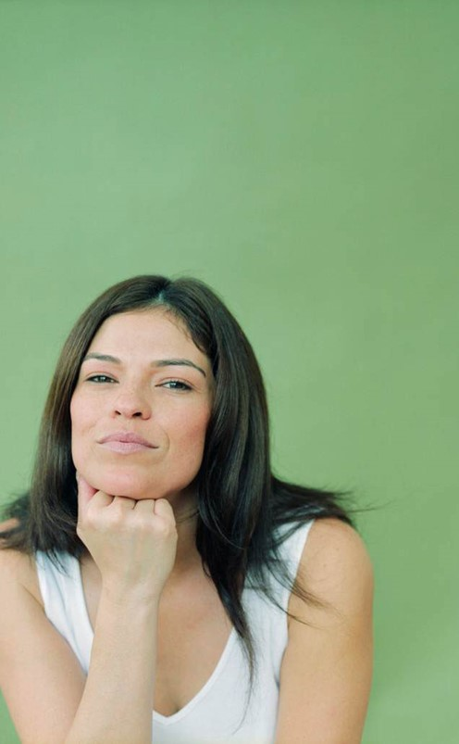
Our Team
Owner Shel Rheingold (with Manager Stefan Linn) leads a talented team of two with over 30 years of experience making pasta by hand, crafting unique flavors that tantalize the palate, and pushing the boundaries of traditional artisan pasta-making.

Slide 4
Let’s Compare
Them
Us
Traditional pasta flavors
Conventional use of all-natural dyes; limited color palette
Repetitive die cut process
Unique favors built on tradition
Innovative use of all-natural dyes; wider color palette
Minimal dye cut process

Slide 5
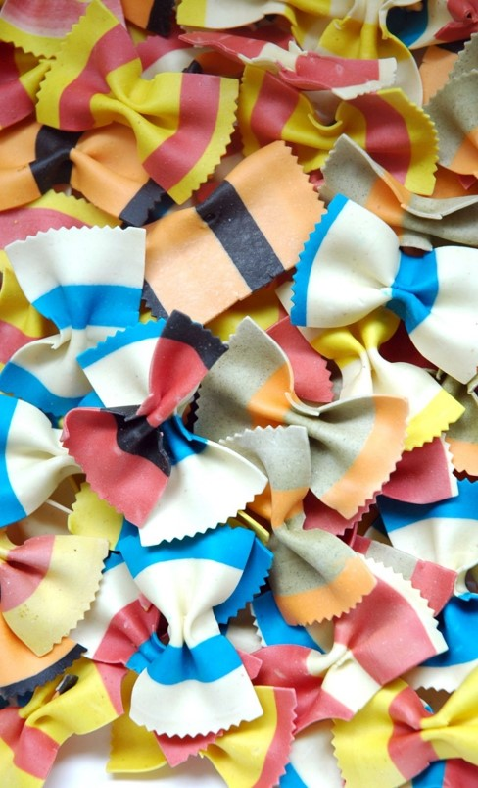
The Goods
Zesty Black Bean Fettuccini
Sundried Tomato Fettuccini
Thai Basil Fettuccini
Roasted Red Pepper Penne
Stefan’s Striped Bowties
Massaman Curry Penne
Wild Mushroom Penne
Shel’s Spanakopita Bowties

Slide 6
Shop, or Visit Our Kitchen
1009 Craftsman Drive
Portland, Maine
Hours Contact
9:00-5:00 Tues-Sun 202-555-1145
Closed Mon shel@bellopasta.com

