Slide 1
Texlahoma High School
Terrier Tough!
Band Boosters Meeting
July 1, 2013

Slide 2
Agenda
New Officers
  Elections and Thank You
  Announce New Officers
  Distribute Officer Contact Info
Fundraising
  Past and Present Ideas
  Review Yearly Results

Slide 3
New Officer Announcement
2013-2014 School Year

Slide 4
Elections and Appreciation
Elections were held in June
for new Band Boosters officers for the
2013-2014 school year.
Before we welcome our new officers,
we want to give a huge THANK YOU to our 2012-2013 officers for a spectacular year and for all their hard work!

Slide 5
New 2013-14 Band Booster Officers
Officer Position | Member
President | Ms. Sara Morales
Vice President | Mr. Terrance Miller
Accounting | Ms. Sandra Lee
Fundraising Chair | Ms. Julia Stevens
Secretary | Mrs. Gwen Pierce
Congratulations & Welcome!

Slide 6
Fundraising
Past and Future

Slide 7
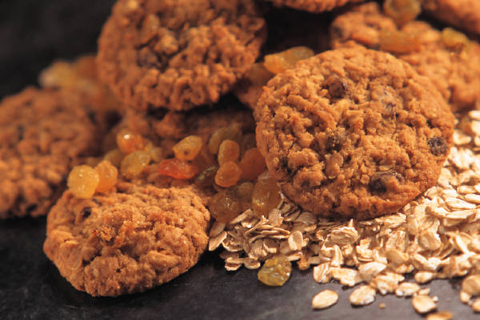
Possible Fundraising Projects
Previous Projects
  Bake Sale
  Candy bar Sale
  Walk-a-thon
  Wrap Gifts at Local Mall
  Card Kit Sales
New Project Ideas
  Candy-grams for Kids
  Car Wash
  Idol Contest –
  Pay Per Vote

Slide 8
Past Fundraising Results

Slide 9
Choose 2013-2014 Projects
Need to Choose Fundraising Projects
  5 projects per school year
  Each lasts 6 weeks, with 2 week break in between
  Need Project Coordinators
  Review monetary benefits of projects
Project Coordinator’s Responsibility :
  Best way to coordinate project
For Suggestions or Participation, Contact :
  Julia Stevens, Fundraising Chair at jstevens686@163.com

Slide 10
Next Meeting
July 15, 2013

Slide 11
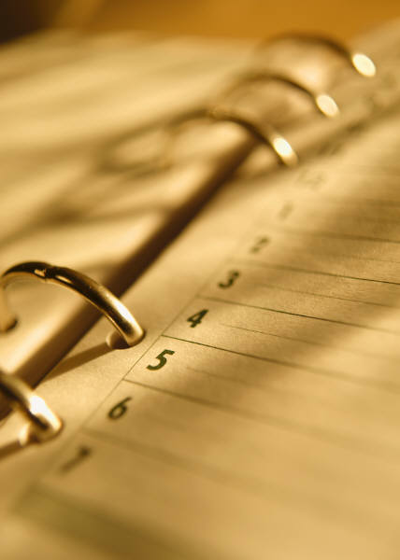
See You Next Month!
Next Meeting:
  July 15th - 7 p.m.
  Back to School – Recruit New Members
  Finalize Fundraising Calendar and Assign Coordinators

