Slide 1

Geb
BIOFUELS
Employee
Wellness Program
Sneak Peak

Slide 2

New Wellness Program
Geb BioFuels will be implementing its new Wellness Program in January.
The program will provide resources and opportunities for employees to improve their overall health.

Slide 3

Health and Wellness Screenings
Screenings for Blood Pressure, Cancer, Heart Attack/Stroke Risk, Diabetes and more
Provided by University Hospital Community Outreach and Health Education Programs

Slide 4

Healthy Weight Seminars
Nutrition education
Healthy food preparation
Food shopping tips
Responsible weight loss planning
Tips for long-term weight management

Slide 5
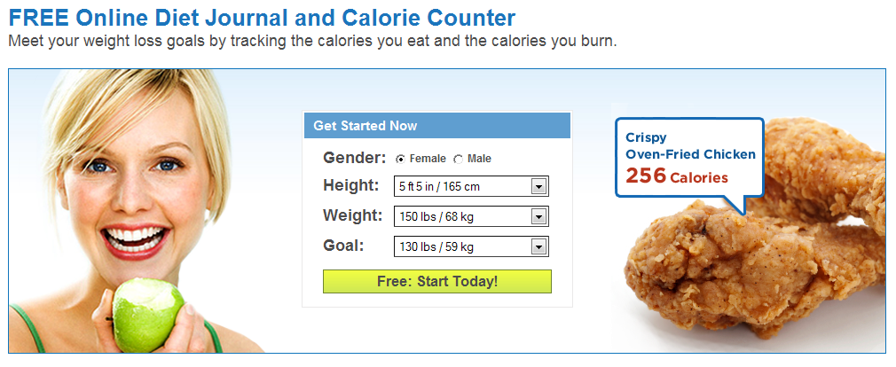
Web Tools for Tracking Your Health Goals
Learn about free online tools that can help you keep track of your goals

Slide 6

Stress Management Tips
Relaxation Techniques
Positive Communication
Time Management
Establishing Priorities
Conflict Resolution
Counseling Programs

Slide 7

Fitness Center Discounts
Flexible hours
Multiple TVs
Pool (Lap Swim)

Slide 8

Monthly Wellness Newsletter

