Slide 1
About Our Business
Mongibello Artisan Pasta

Slide 2
Our Mission
To create unique, high quality pastas, made by hand without additives or preservatives, for restaurants and individuals who choose to serve delicious, all-natural, one-of-a-kind pastas.

Slide 3

Our Team
Owner Shel Rheingold (with Manager Stefan Linn) leads a talented team of two with over 30 years of experience making pasta by hand, crafting unique flavors that tantalize the palate, and pushing the boundaries of traditional artisan pasta-making.

Slide 4
Let’s Compare
Them
Us
Traditional pasta flavors
Conventional use of all-natural dyes; limited color palette
Repetitive die cut process
Unique flavors built on tradition
Innovative use of all-natural dyes; wider color palette
Minimal die cut process

Slide 5
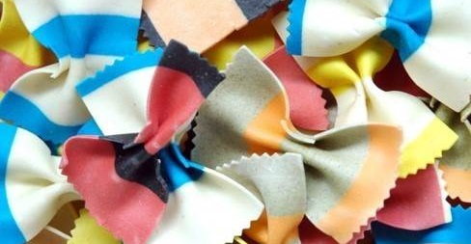
The Goods
Zesty Black Bean Fettuccini Sundried Tomato Fettuccini Thai Basil Fettuccini Roasted Red Pepper Penne Massaman Curry Penne Wild Mushroom Penne Shel’s Spanakopita Bowties Stefan’s Striped Bowties

Slide 6
Shop, or Visit Our Kitchen
1009 Craftsman Drive
Portland Main
Hours Contact
9:00-5:00 Tues-Sun 207-555-1142
Closed Mon shel @ bellopasta.com

